Slide 1
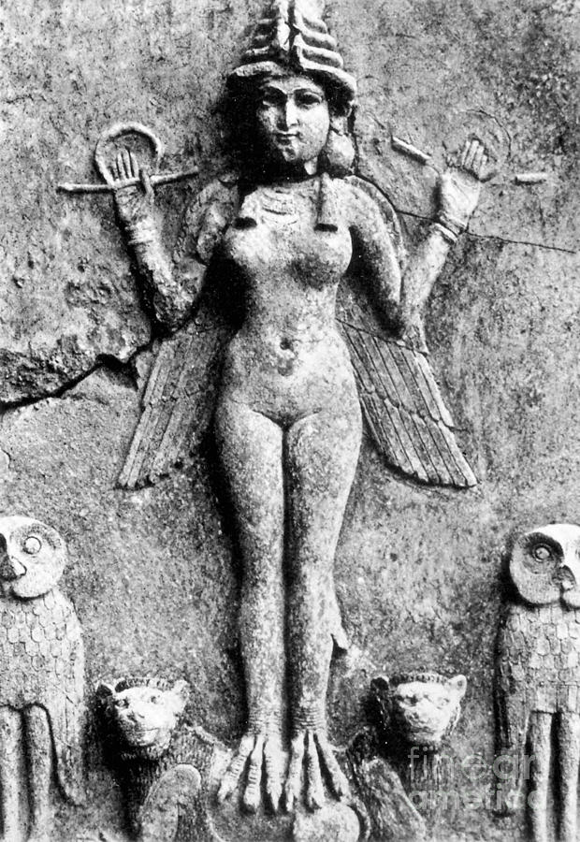
Lilith, Gender, and Demonology in Early Modern Europe
Stephanie Spoto
Monterey Peninsula College
16 February 2022

Slide 2
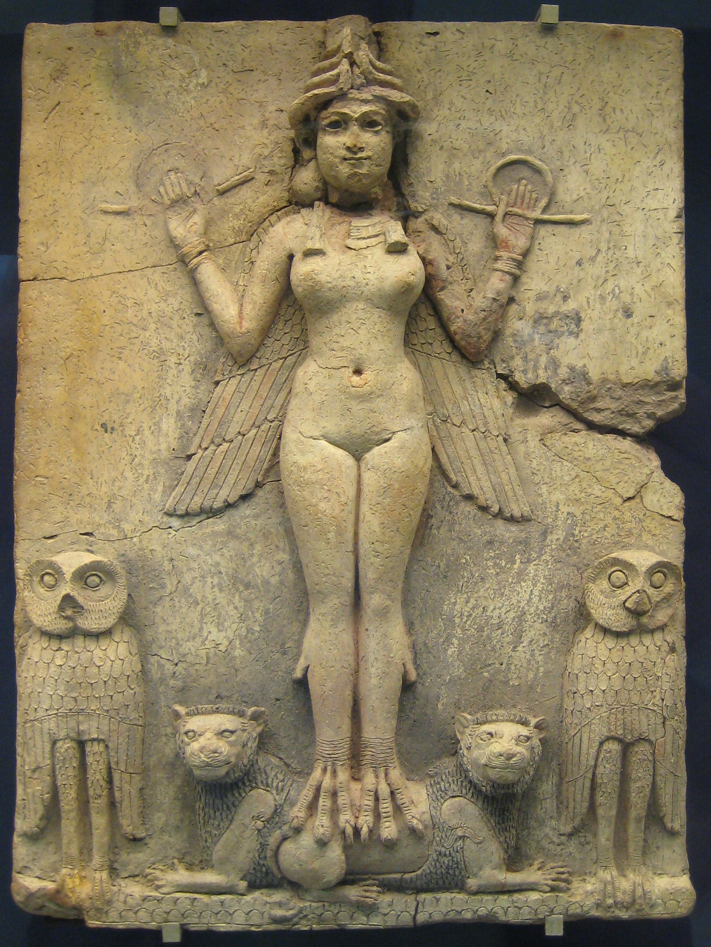
2

Slide 3
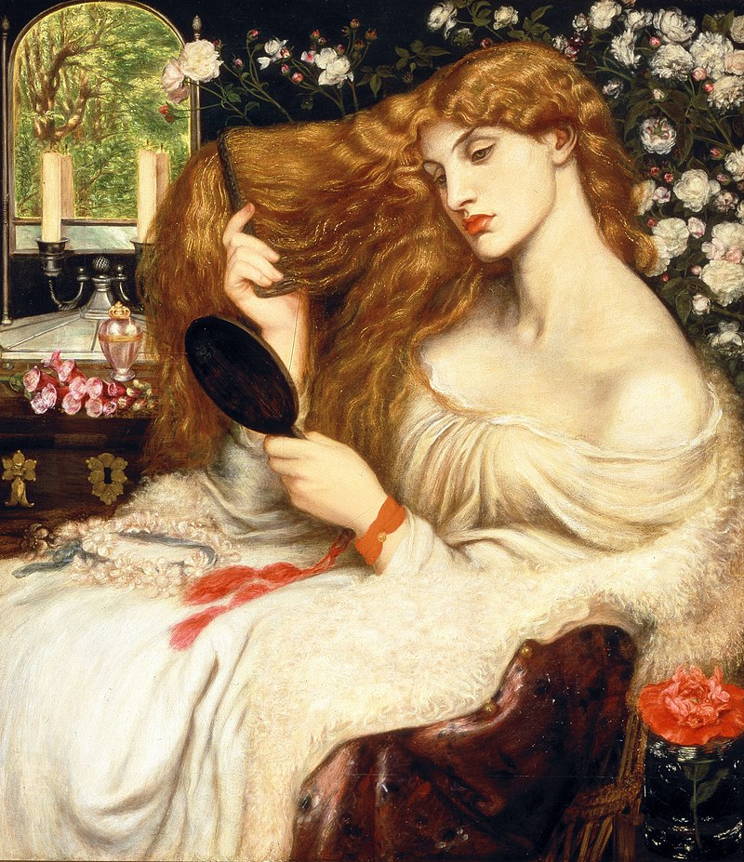
Lady Lilith
Dante Gabriel Rossetti
1866
3

Slide 4
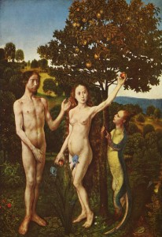
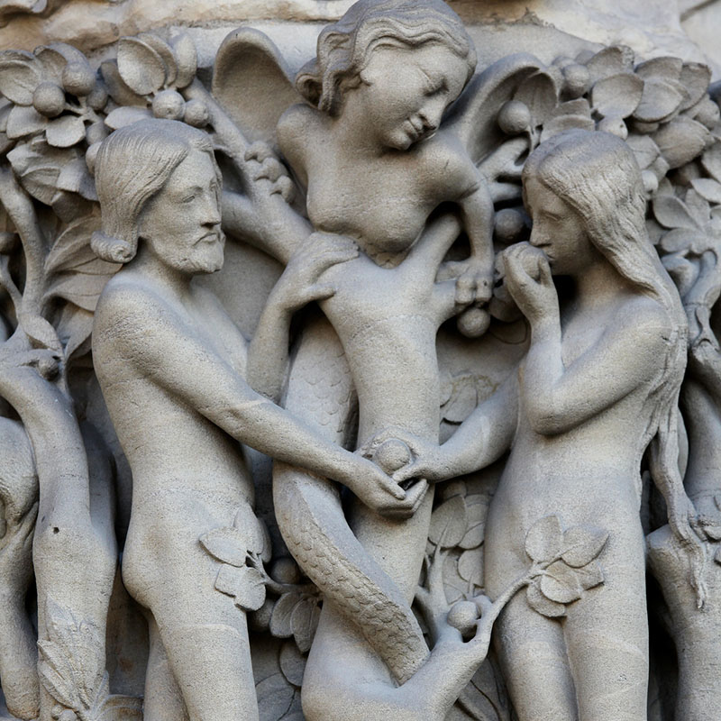
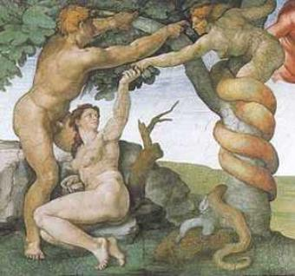
"The Fall of Man and the
Expulsion From Paradise"
Michelangelo
c. 1509
“Sündenfall”
Hugo Van Der Goes
c. 1487
Adam, Eve, and the (female)
Serpent (often identified as Lilith)
at the entrance to Notre Dame
Cathedral in Paris.
c. 1413
4

Slide 5
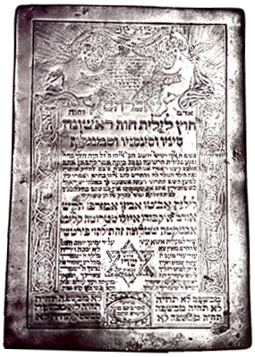
Alphabet of Ben Sirah (c. 700-1000 CE)
5

Slide 6
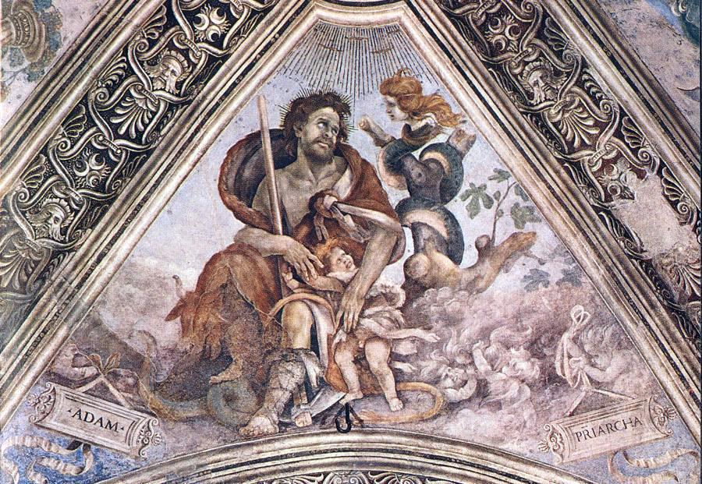
Adam clutches a child in the presence of Lilith
Filippino Lippi
1502
6

Slide 7
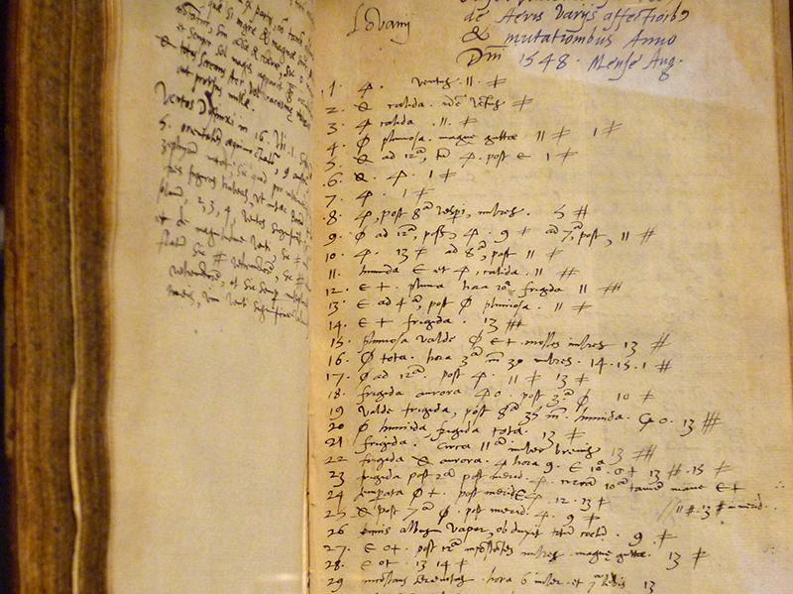
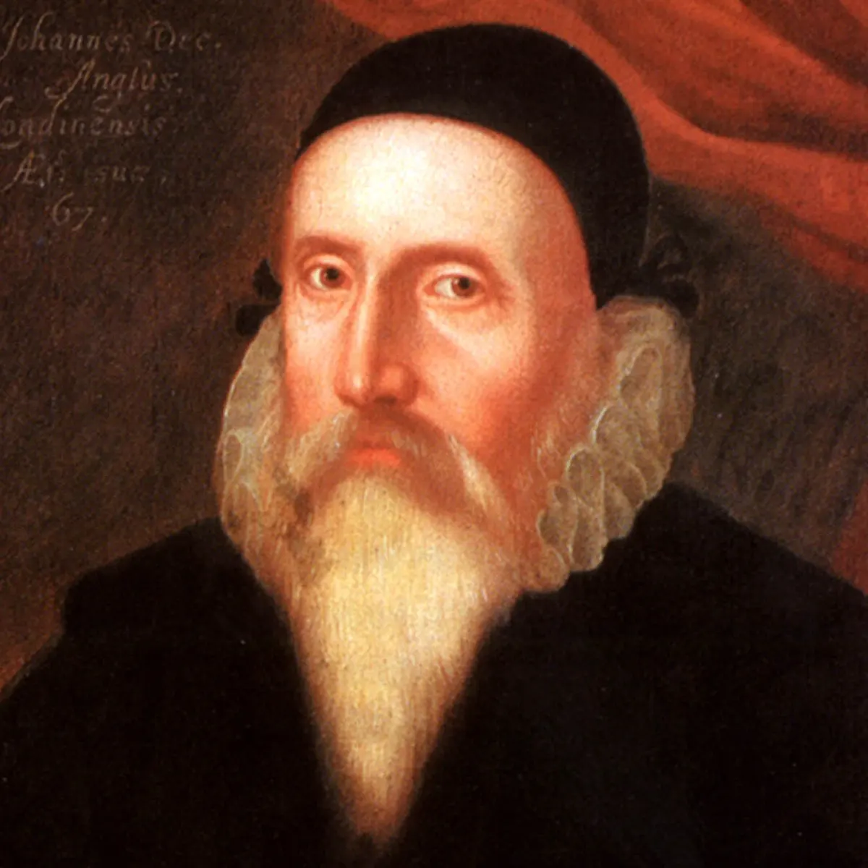
From the notebooks of John Dee (1527-1608)
7

Slide 8
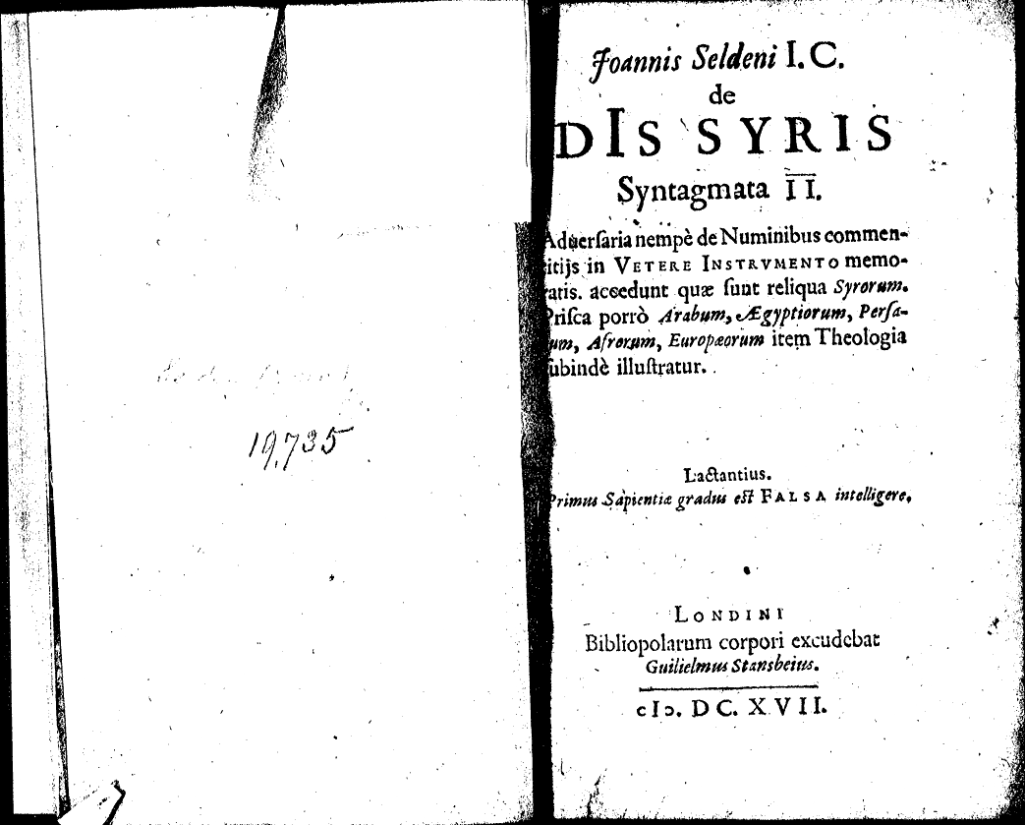
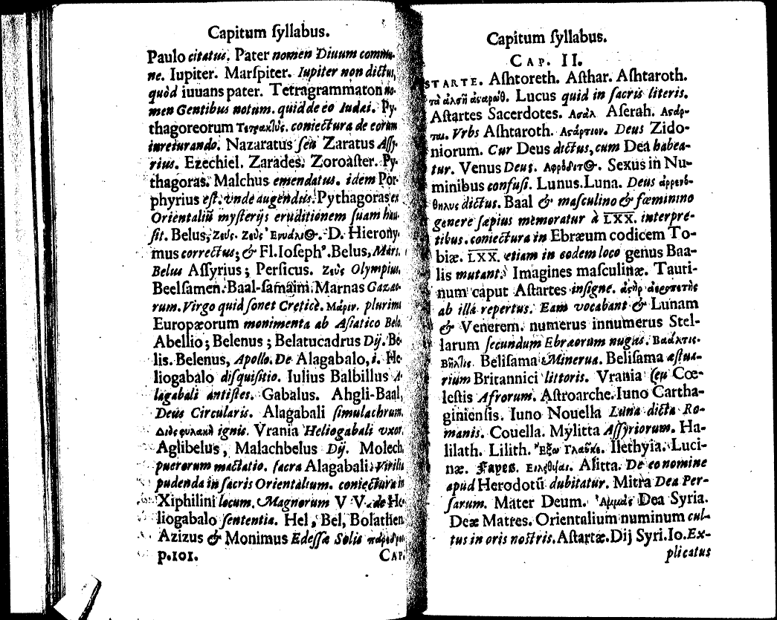
8

Slide 9
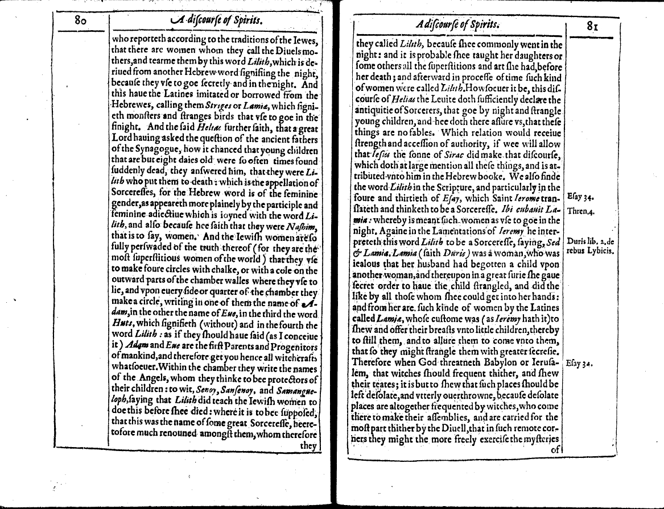
Sébastien Michaelis
The Admirable History...
1613
Sébastien Michaelis
The Admirable History...
1613
Sébastien Michaelis
The Admirable History...
1613
9

Slide 10
John Lightfoot
Ervbin
1629
10

Slide 11
11

Slide 12
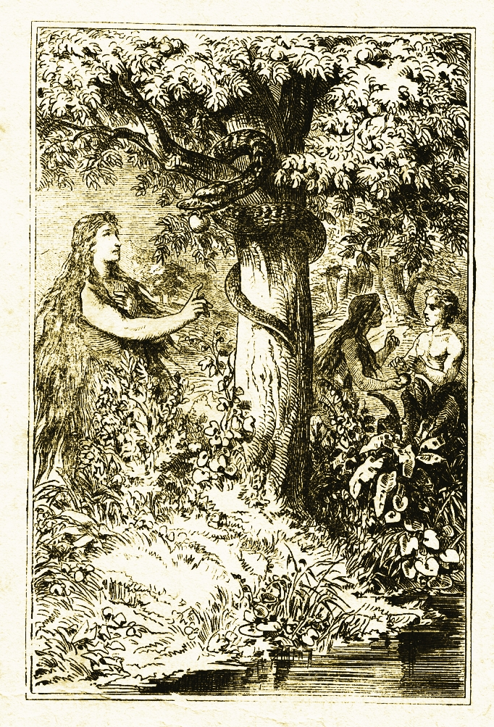
Leon of Modena, 1650
Lilith, illustration by Carl Poellath from 1886
12

Slide 13
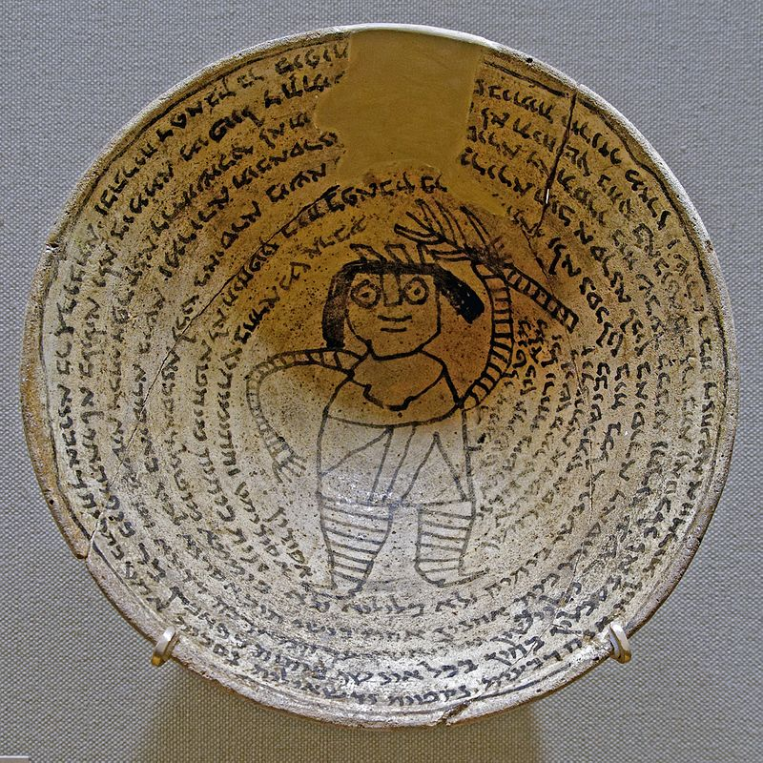
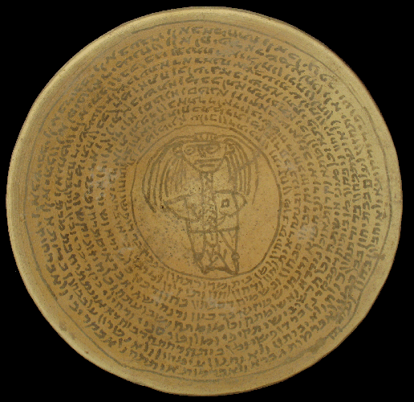
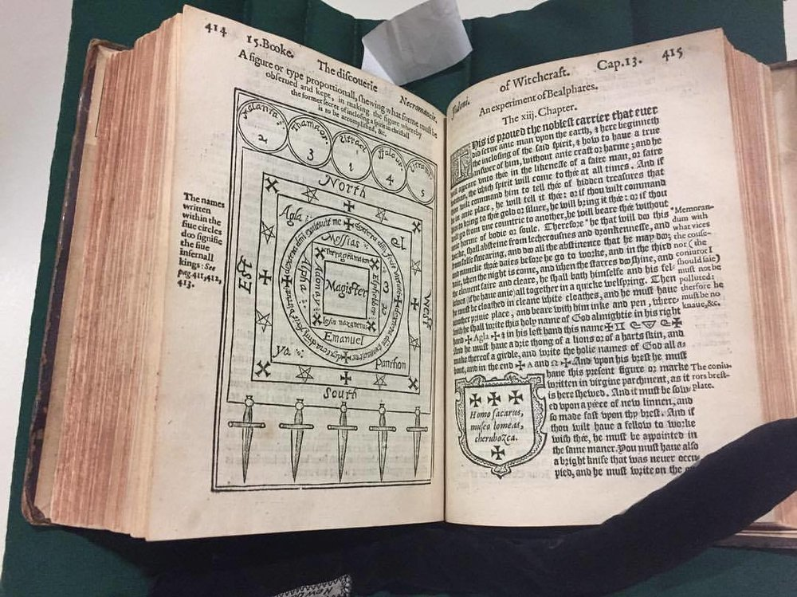
13

